Slide 1

Can You Feel My Heartbeat?
AED
김민상 김재환 김혜정 이예람 정지은

Slide 2
Can You Feel My Heartbeat?
Conventional Mood Light is only brightened, but <Can You Feel My Heartbeat?>is controlled by the heartbeat
We can listen to music that is similar to our BPM and suits our psychological state.

Slide 3
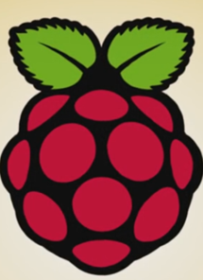
What Is Different?
Unlike conventional lighting, it integrates multiple functions at once.
Measuring BPM of heart and transmits it
↓
Playing music and differing brightness and color of light according to BPM
Using Raspberry PI →
This creates a variety of functions that are more open than Arduino.

Slide 4
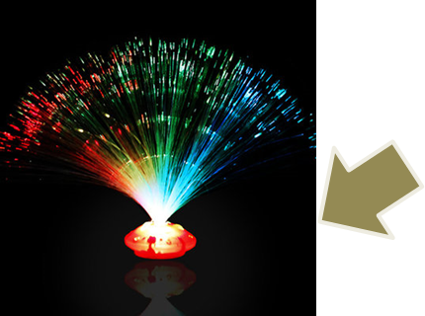
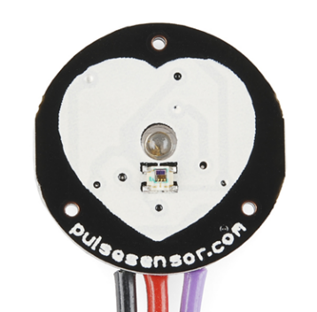
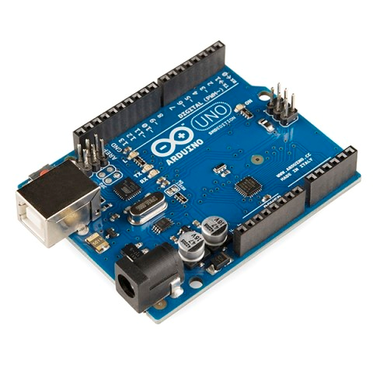
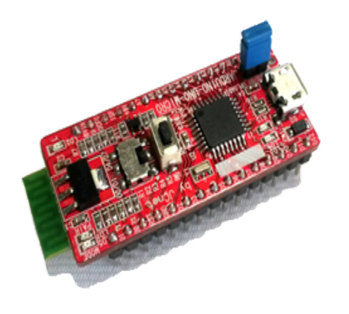
The parts used
Optical fiber
Sending the light the LED
Heart rate sensor
Measuring BPM per minute.
Arduino
Receiving the BPM and controlling the LED light.
Raspberry PI
It plays music of BPM similar to heart rate.
Jarduino uno BT mini
Receiving BPM and sending it to the Arduino.

Slide 5
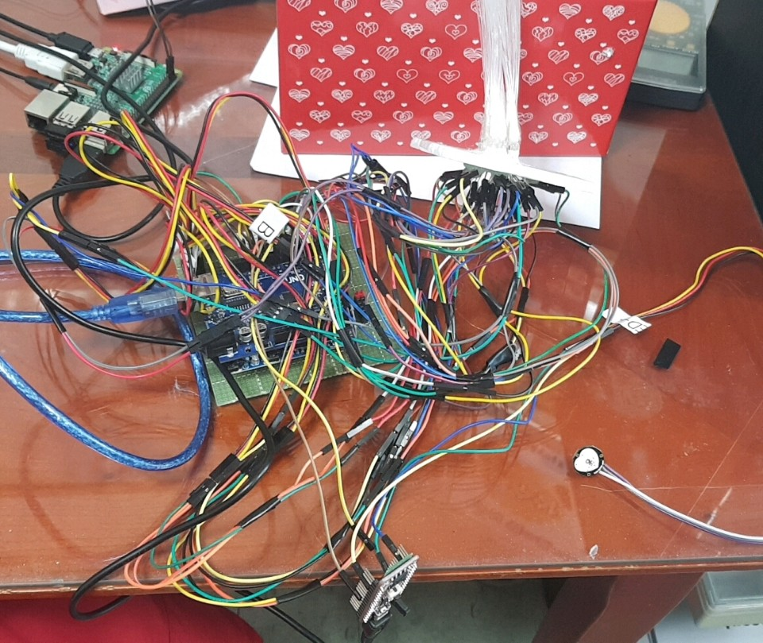
Immediate constituent
LED,
Optical fiber
Raspberry PI
Arduino UNO
Heart rate sensor
Jarduino uno
BT-mini

Slide 6
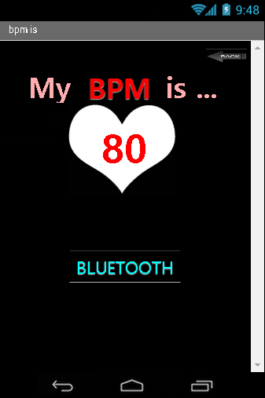
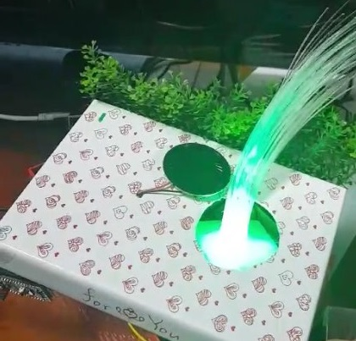
How it Works
Touch your finger to the heart rate sensor.
Sending and receiving bpm at Jarduino.
코딩
Sending and receiving bpm at Arduino.
Playing music that matches bpm by Raspberry PI.
Checking heart rate and controlling song on/off with app.
Controlling LED brightness and speed according to bpm.

Slide 7
Why we used it ? → In addition to this project, I used Raspberry PI to make IOT technology an easy-to-use environment.
Production process → We controlled the Linux environment from Raspberry PI to Python. We created a program that when it received the BPM value from Arduino, automatically plays music similar to the BPM value.
RASPBERRY
PI

Slide 8
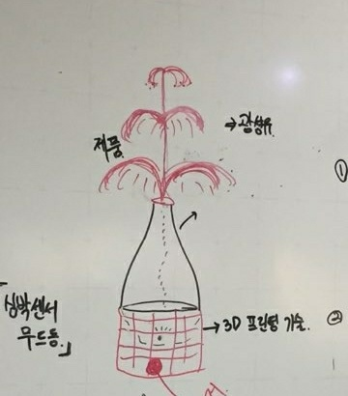
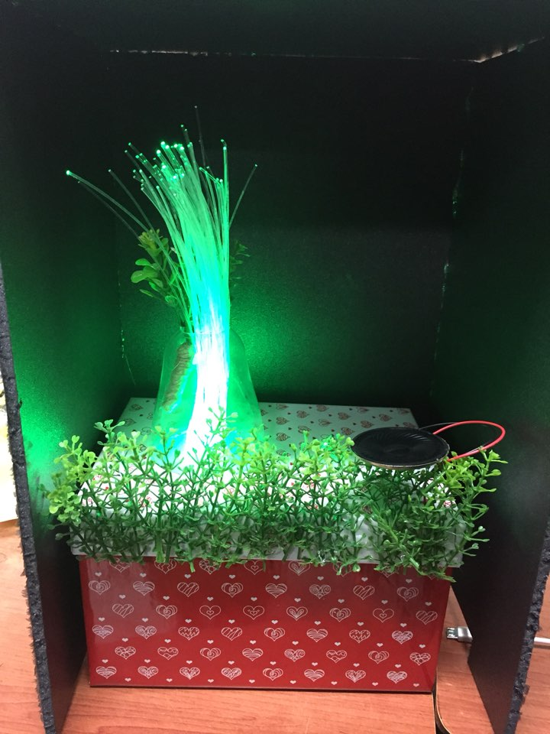
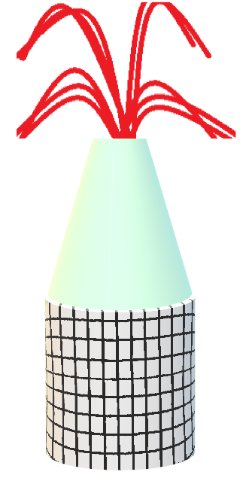
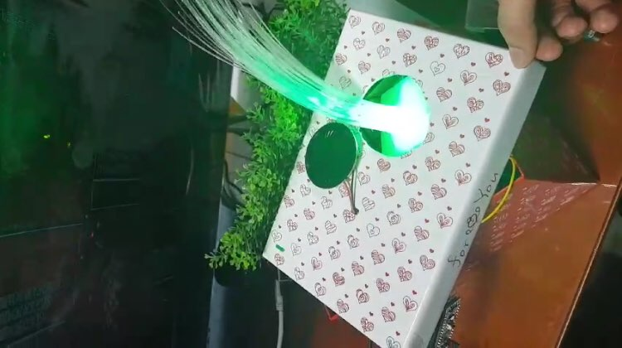
개발 과정2
Development process – Design
코딩

Slide 9
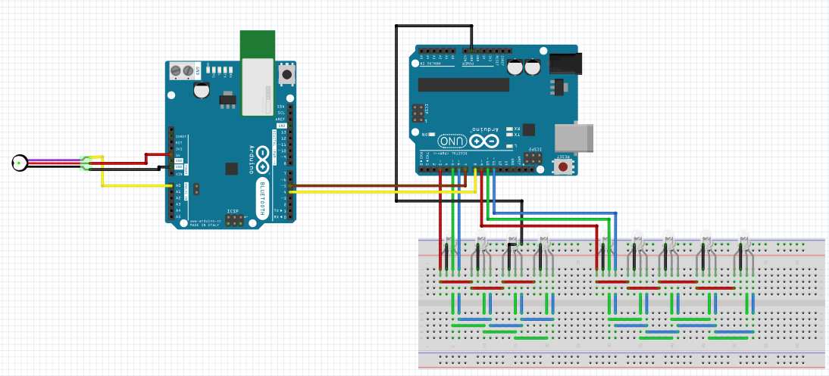
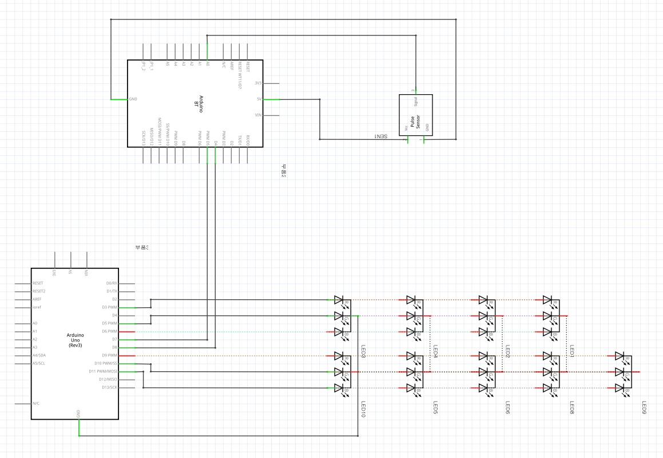
개발 과정2
Development process – The circuit diagram
코딩

Slide 10
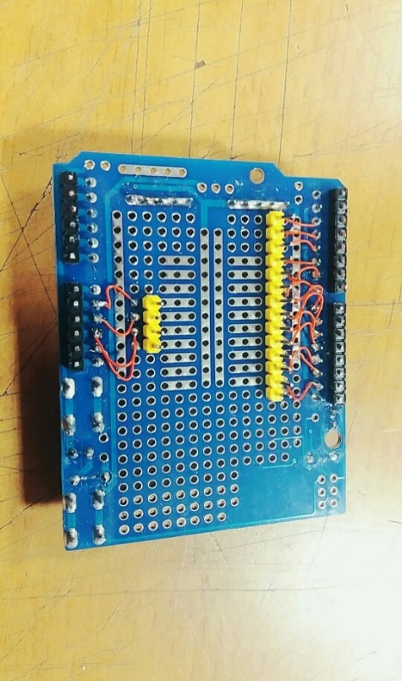
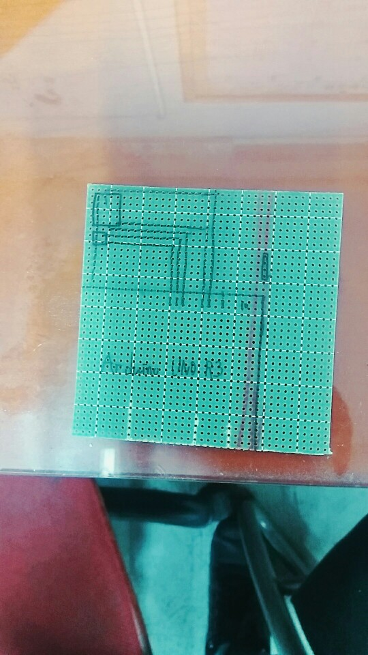
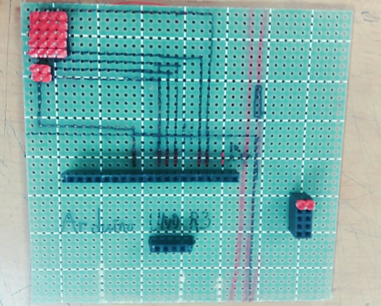
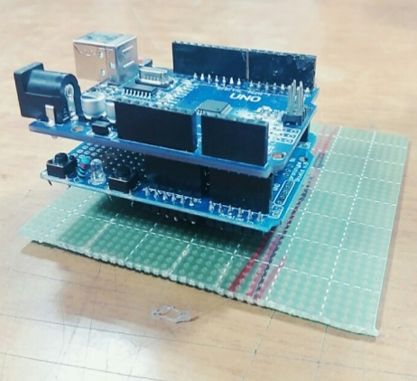
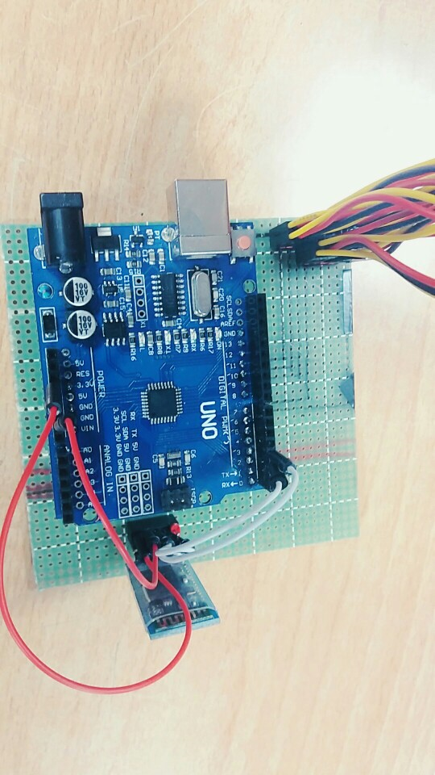
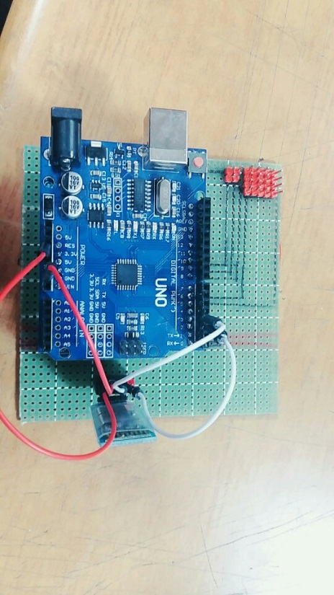
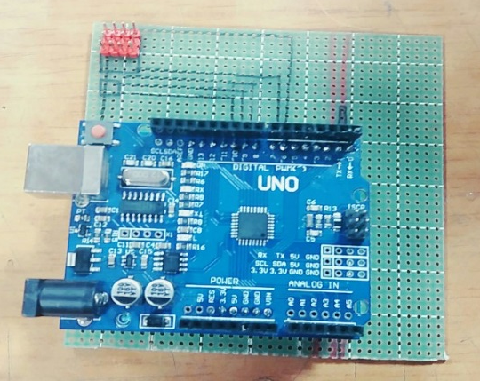
Development process - Soldering
완성!

Slide 11
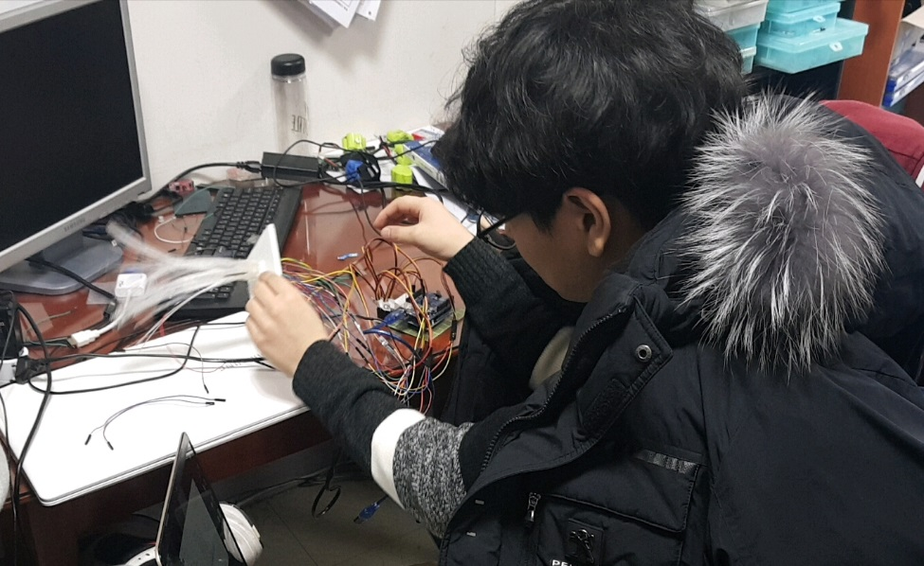
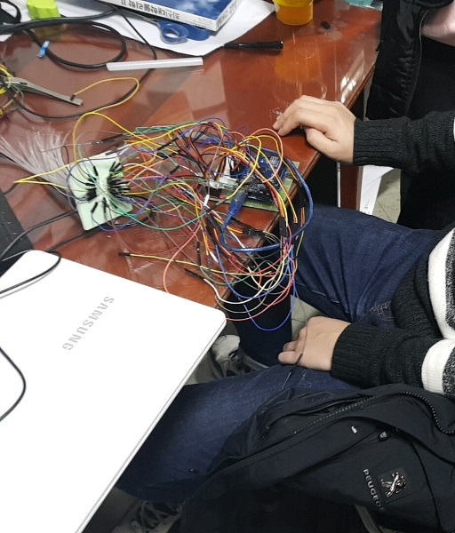
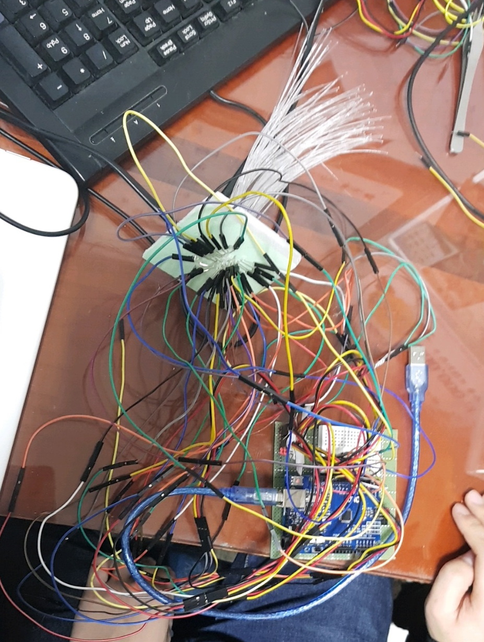
개발 과정2
Development process – LED Connection
코딩

Slide 12
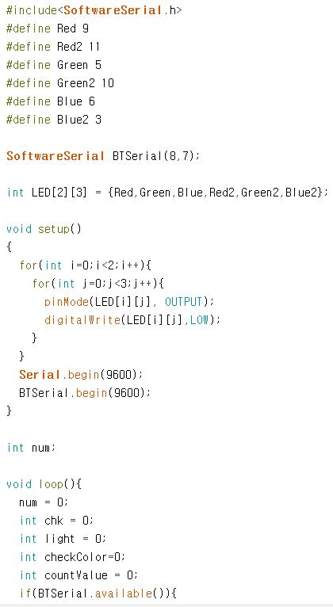
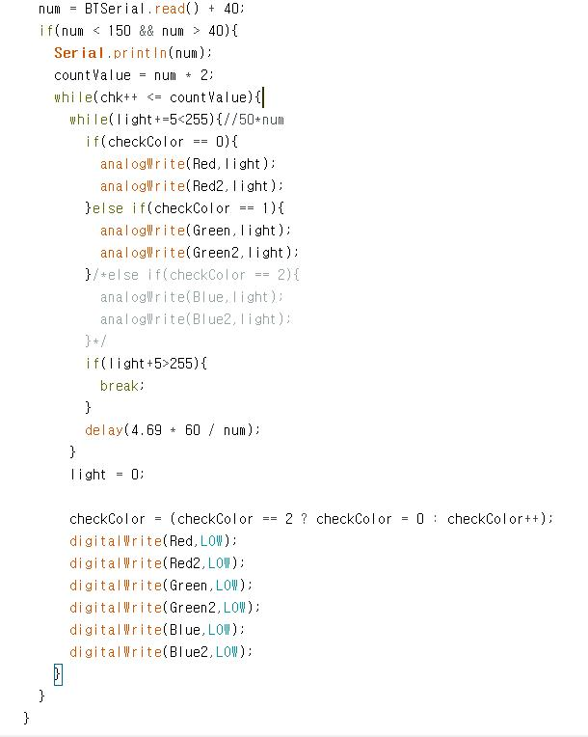
개발 과정2
Development process – Arduino
코딩

Slide 13
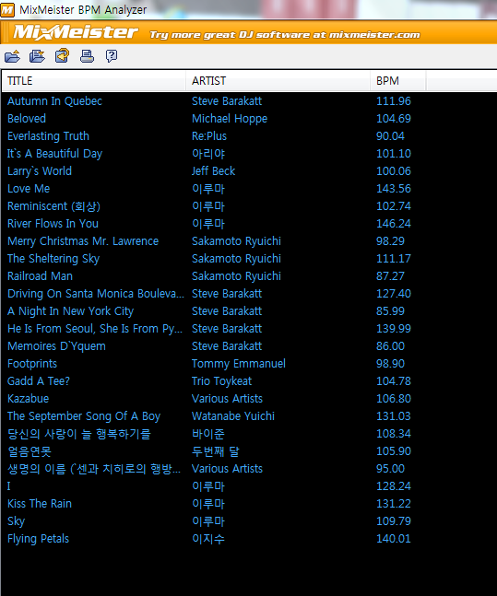
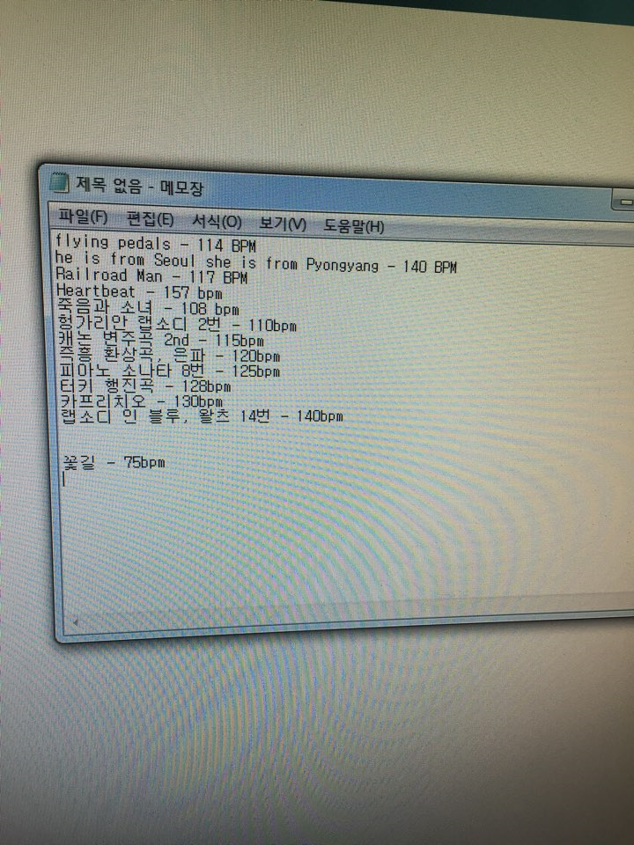
Development process – Finding music BPM

Slide 14
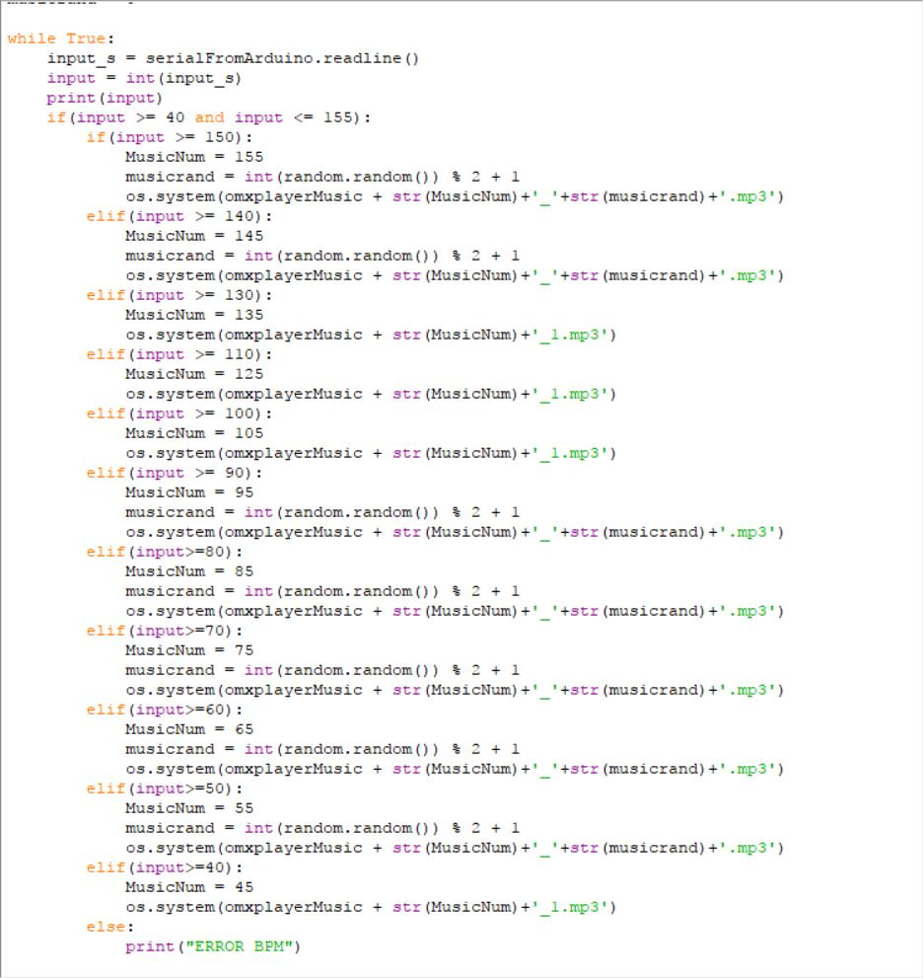
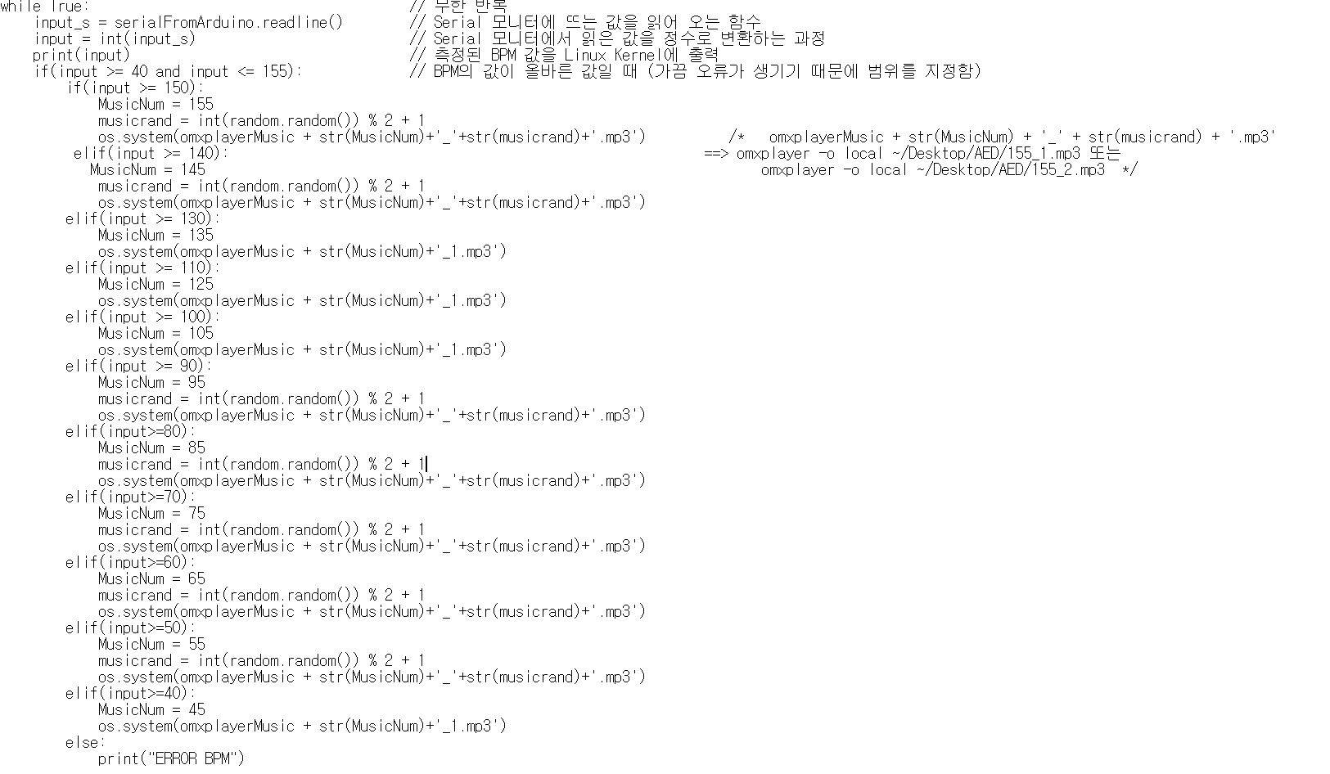
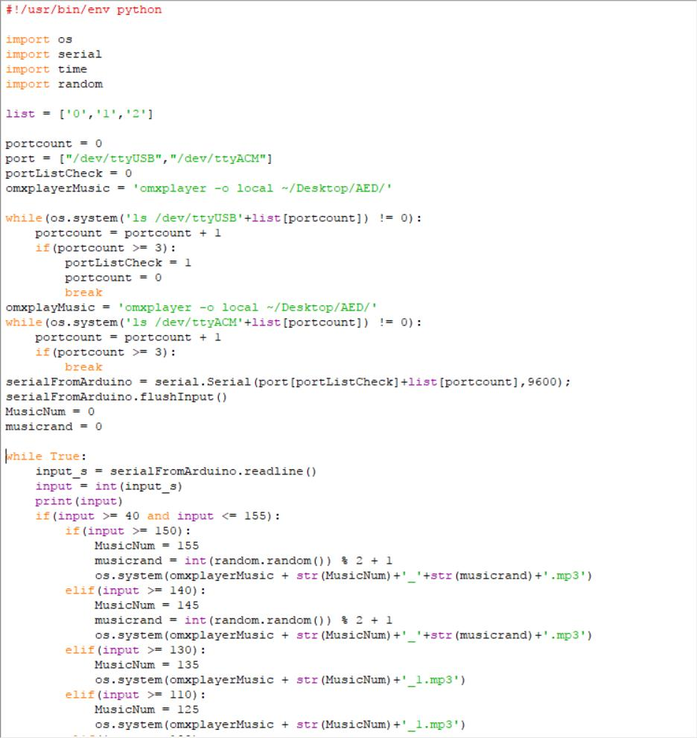
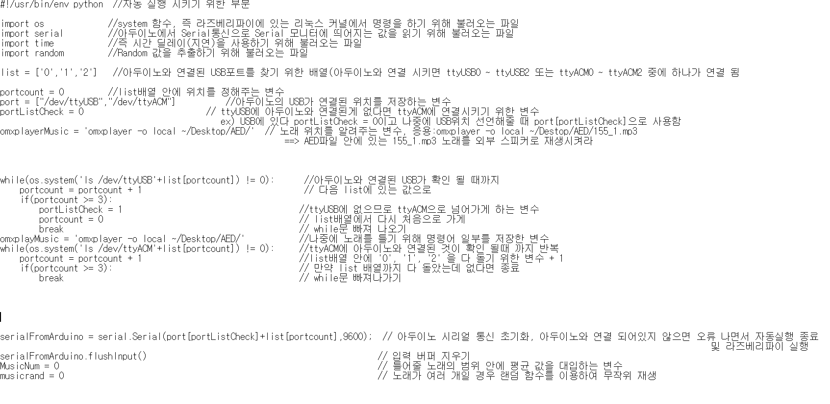
개발 과정2
Development process – Raspberry PI
코딩

Slide 15
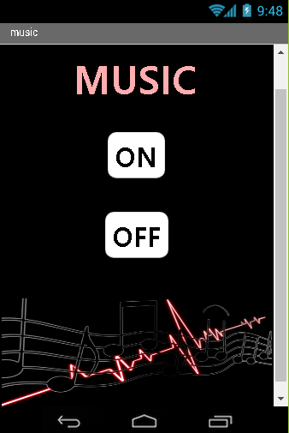
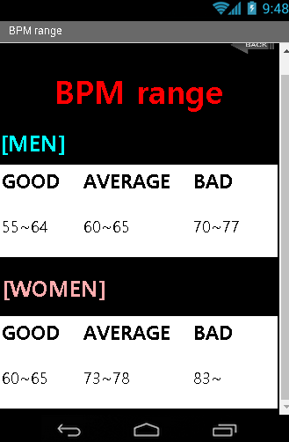
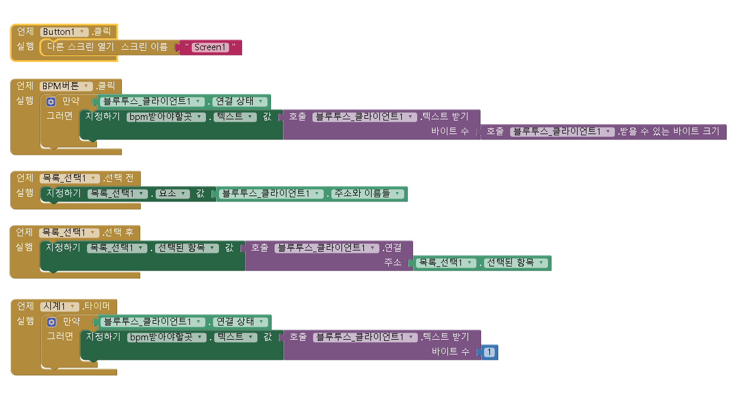
Development process – Developing App
We created an app using App Inventor
We can receive and confirm the measured BPM value
using Bluetooth.
Music on/off can be controlled.
This tells us the average heart rate value, which can be
compared to our own.

Slide 16
Increased accessibility to vital sign
We can visually confirm our condition through Mood light.
Expected Effect
Combination of BT and IT →
Match with other fields
stabilizing the mind by listening to music that is similar to the vital sign.

Slide 17
개과정2
코딩
Thank you for listening!

